Slide 1
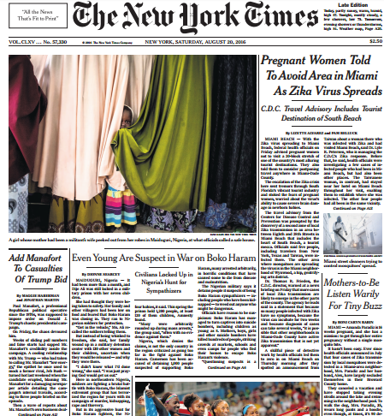
FIRST FIVE ARE SACRED.
Weekly News Quiz!
Copyright: Uncommon Schools. Unless otherwise noted, all of the content in this resource is licensed under a Creative Commons Attribution International 4.0 (CC BY-NC-SA) license.

Slide 2
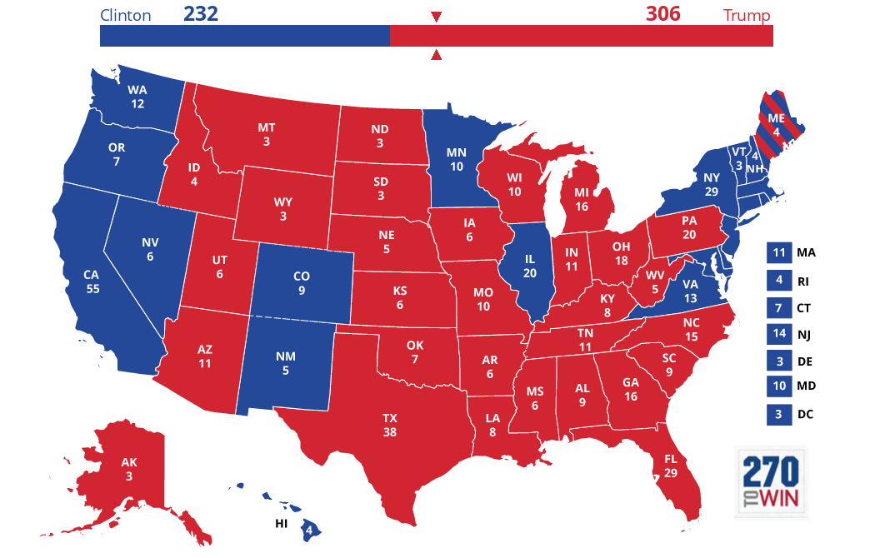
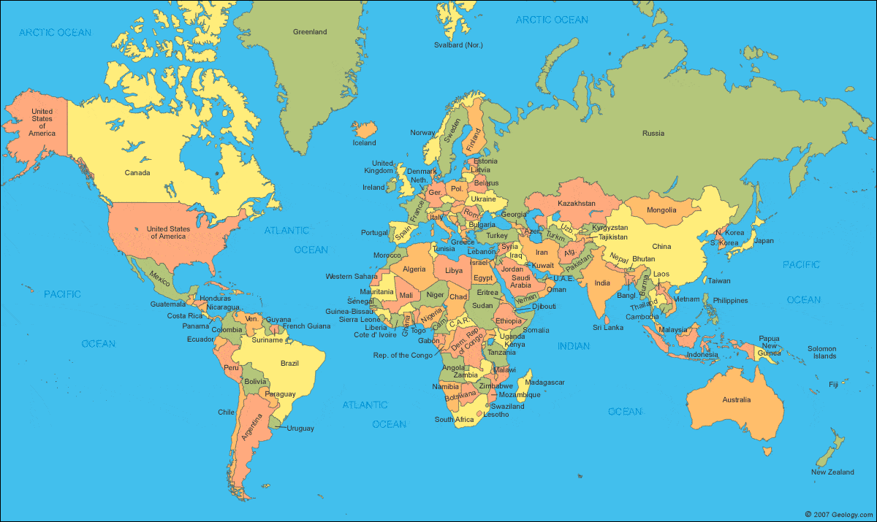
News Discussion

Slide 3
“We must run while others walk.”
OBJECTIVE
SWBAT script their individual presentation, worth 10.5% of their AP score.
AGENDA
Presentation Scripting

Slide 4
Unit 4 Calendar

Slide 5
PT2 Progress Check
On Track | Almost There | Off-Track

Slide 6
Shout Outs!
Student 1
Student 2
Student 3

Slide 7
Agenda
Presentation Scripting

Slide 8
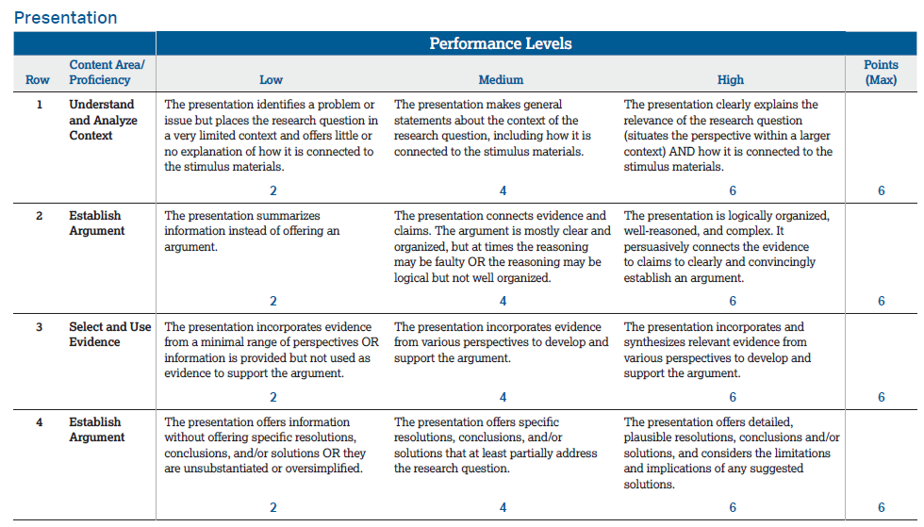
IP Scripting

Slide 9
Endnotes
New York Times. Uncommon Schools does not own the copyright for the New York Times image used in this presentation and claims no copyright in this material. The material is being used exclusively for non-profit educational purposes under fair use principles in U.S. Copyright law. The user should make the judgment about whether this material may be used under fair use/fair dealing permissions in the user’s country.
Author and Source Unknown. Uncommon Schools does not own the copyright for images used in this presentation and claims no copyright in this material. The material is being used exclusively for non-profit educational purposes under fair use principles in U.S. Copyright law. The user should make the judgment about whether this material may be used under fair use/fair dealing permissions in the user’s country.

