Slide 1
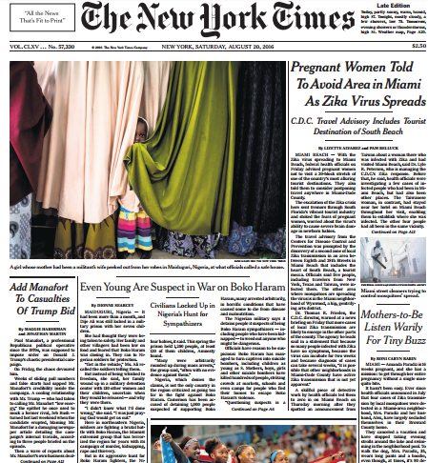
FIRST FIVE ARE SACRED.
Weekly News Quiz!
Copyright: Uncommon Schools. Unless otherwise noted, all of the content in this resource is licensed under a Creative Commons Attribution International 4.0 (CC BY-NC-SA) license.

Slide 2
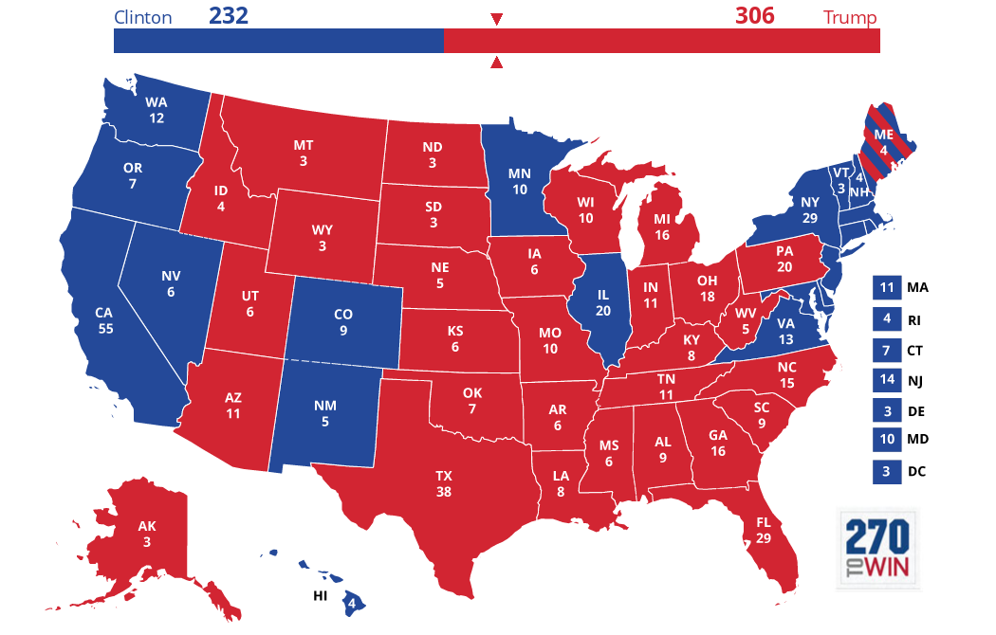
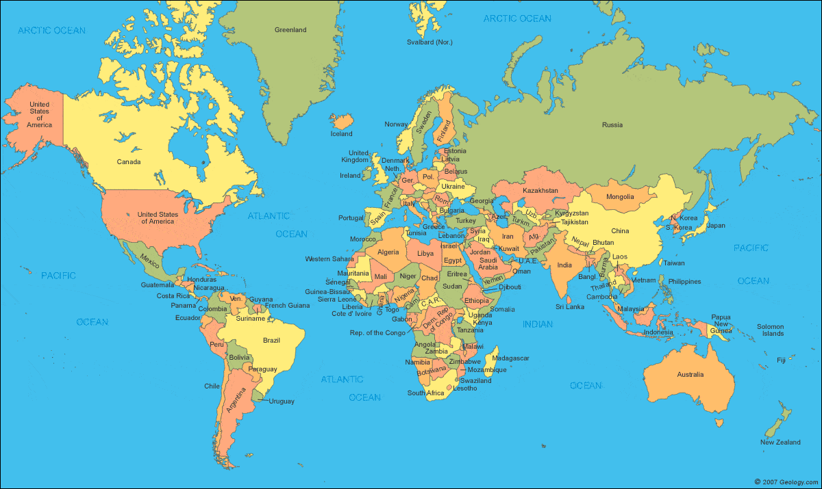
News Discussion

Slide 3
“We must run while others walk.”
OBJECTIVE
SWBAT synthesize evidence to develop and support a compelling argument.
AGENDA
Using Effective Evidence

Slide 4
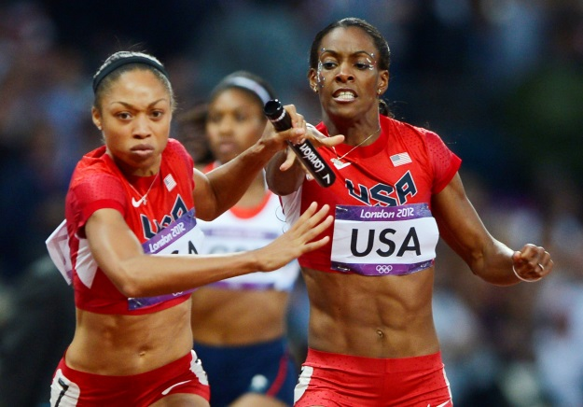
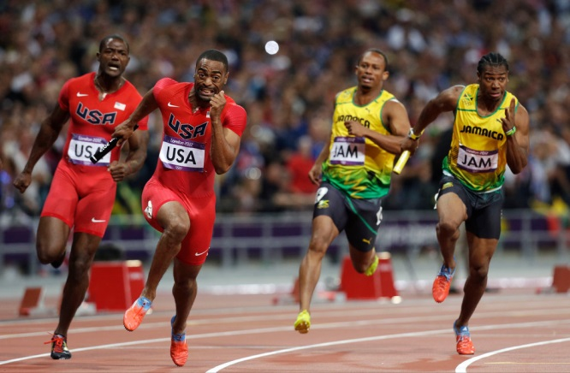
Be your own “fastest runner.”

Slide 5
Unit 4 Calendar

Slide 6
The EOC is…
13 days away!

Slide 7
Agenda
Using Effective Evidence

Slide 8
S
STRONG
&
R
eputation
ufficient
A
bility to observe
C
redible
V
ested interest
A
ccurate
E
xpertise
R
elevant
N
eutrality

Slide 9
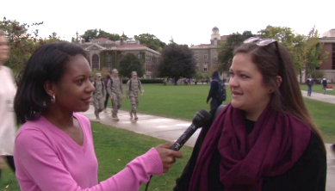
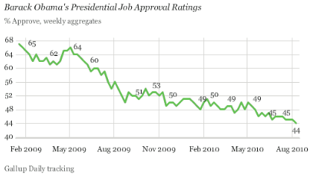
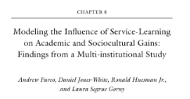
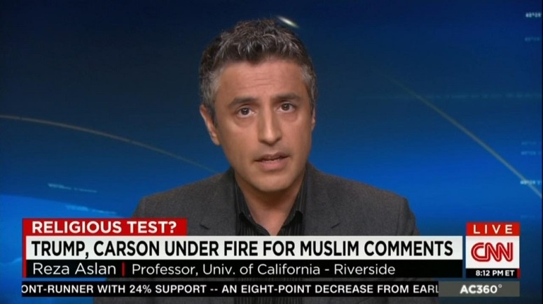
Evidence Types
Anecdotal
Statistical
a personal account
numerical data
Scholarly
Authorities
peer-reviewed & published by experts in the field
experts in the field

Slide 10
Find supporting evidence!
Revolutions are only successful with if they begin with the grassroots and the will of the broader people, rather than a small segment of the population.

Slide 11
Find supporting evidence!
Revolution and lasting societal change are driven by untenable conditions of inequality and injustice.

Slide 12
Writing with Evidence

Slide 13
Find supporting evidence!
Revolutions are only successful when led by an inspiring leader with a vision for how to create political and social change.

Slide 14
Endnotes
New York Times. Uncommon Schools does not own the copyright for the New York Times image used in this presentation and claims no copyright in this material. The material is being used exclusively for non-profit educational purposes under fair use principles in U.S. Copyright law. The user should make the judgment about whether this material may be used under fair use/fair dealing permissions in the user’s country.
Author and Source Unknown. Uncommon Schools does not own the copyright for images used in this presentation and claims no copyright in this material. The material is being used exclusively for non-profit educational purposes under fair use principles in U.S. Copyright law. The user should make the judgment about whether this material may be used under fair use/fair dealing permissions in the user’s country.

