Slide 1
FIRST FIVE ARE SACRED.
Complete your Do Now in 4 minutes.
Copyright: Uncommon Schools. Unless otherwise noted, all of the content in this resource is licensed under a Creative Commons Attribution International 4.0 (CC BY-NC-SA) license.

Slide 2
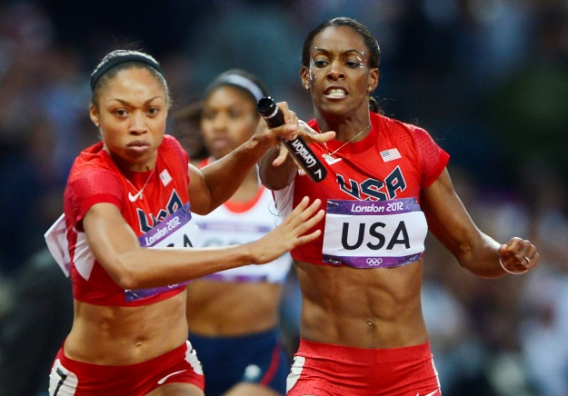
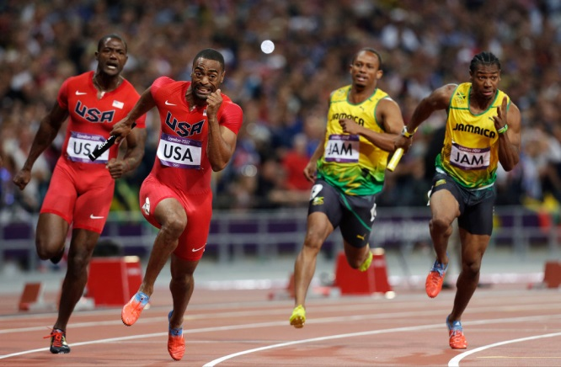
Be your own “fastest runner.”

Slide 3
“We must run while others walk.”
OBJECTIVE
SWBAT generate strong arguments using line of reasoning connections.
AGENDA
Building an LOR

Slide 4
Unit 4 Calendar

Slide 5
The EOC is…
14 days away!

Slide 6
Agenda
Building an LOR

Slide 7
Thesis Brainstorm
Superpower countries such as the United States should accept refugees.

Slide 8
Thesis Brainstorm
In college and career, your social media presence can be just as important as your resume.

Slide 9
Thesis Brainstorm
Not necessarily defined by blood or genetics, a family is a group of people who have committed themselves to each other’s social and emotional well-being.

Slide 10
Thesis Brainstorm
Parents should not perpetuate myths like the tooth fairy and Santa Claus because they serve little purpose besides deluding children into false hopes that the world is full of goodness.

Slide 11
Endnote
Author and Source Unknown. Uncommon Schools does not own the copyright for images used in this presentation and claims no copyright in this material. The material is being used exclusively for non-profit educational purposes under fair use principles in U.S. Copyright law. The user should make the judgment about whether this material may be used under fair use/fair dealing permissions in the user’s country.

