Slide 1
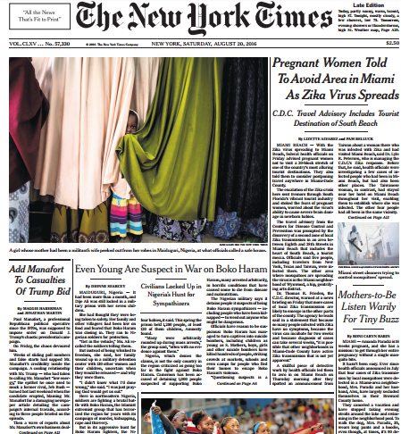
FIRST FIVE ARE SACRED.
Weekly News Quiz!
Copyright: Uncommon Schools. Unless otherwise noted, all of the content in this resource is licensed under a Creative Commons Attribution International 4.0 (CC BY-NC-SA) license.

Slide 2
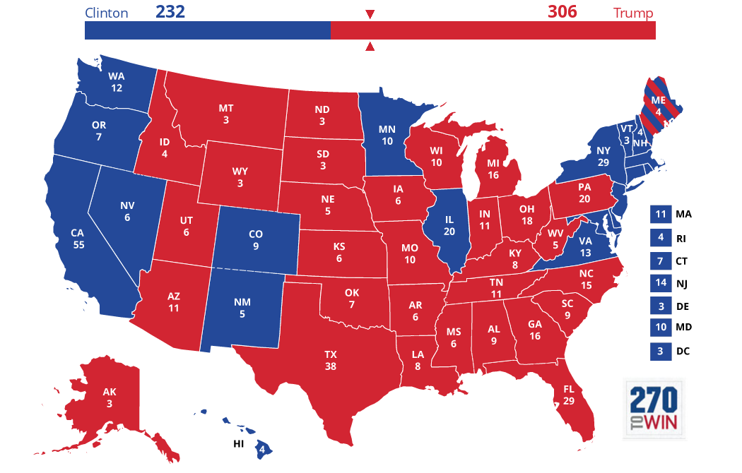
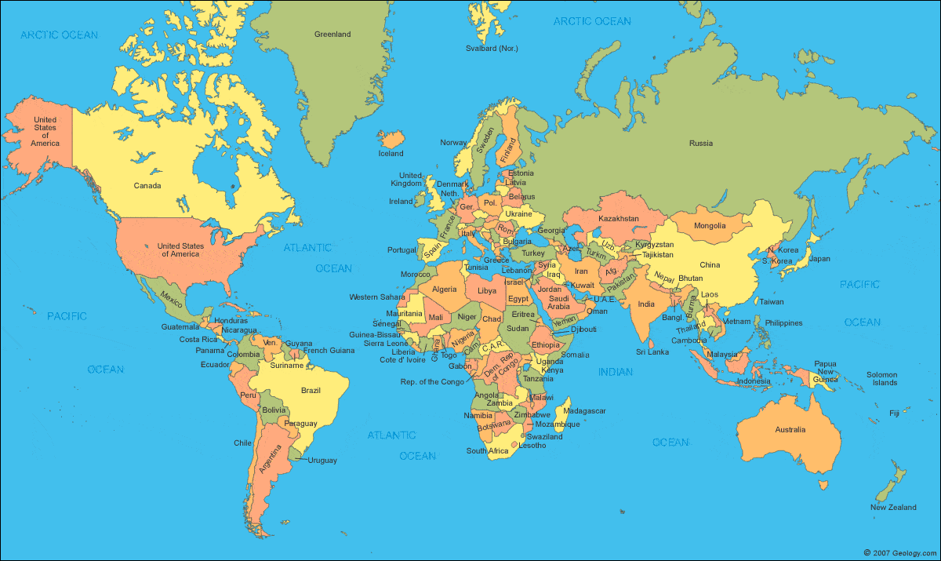
News Discussion

Slide 3
“We must run while others walk.”
OBJECTIVE
SWBAT rehearse their individual presentation, worth 10.5% of their AP score.
AGENDA
Presentation Rehearsal

Slide 4
Unit 4 Calendar

Slide 5
PT2 Progress Check
On Track | Almost There | Off-Track

Slide 6
Agenda
Presentation Slides

Slide 7
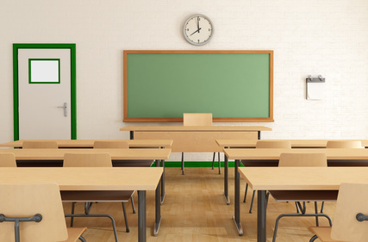
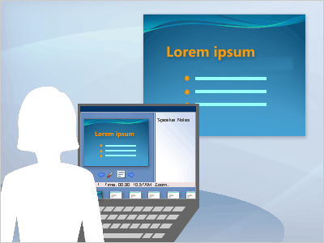
Logistics & Expectations

Slide 8
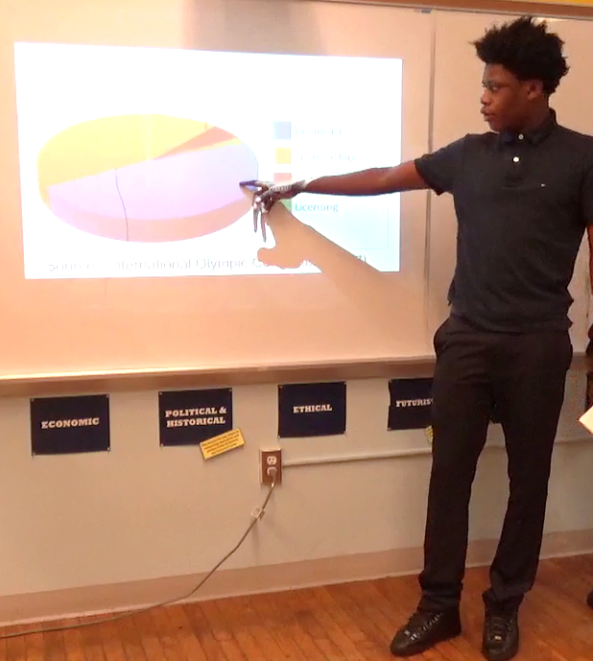
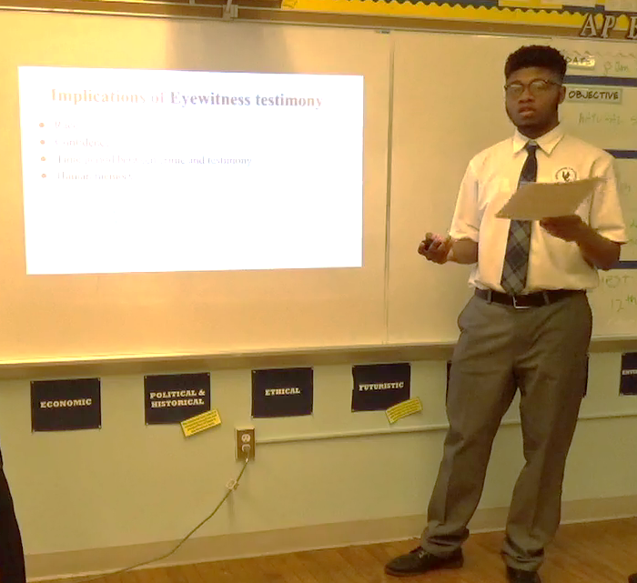
Presentation Tips
Be interesting! Engage the audience!

Slide 9
Room Assignments
Period 1
Table 1 – 407
Table 2 – 413
Table 3 – 414
Table 4 – 415
Table 5 – 417*
Table 6 – 419
Period 6
Table 1 – 405
Table 2 – 406
Table 3 – 407
Table 4 – 413
Table 5 – 419
Modify this slide as needed to match your own presentation rehearsal logistics
Period 5
Table 1 – 407
Table 2 – 416*
Table 3 – 417
Table 4 – 419*

Slide 10
Endnote
Author and Source Unknown. Uncommon Schools does not own the copyright for images used in this presentation and claims no copyright in this material. The material is being used exclusively for non-profit educational purposes under fair use principles in U.S. Copyright law. The user should make the judgment about whether this material may be used under fair use/fair dealing permissions in the user’s country.

