Slide 1
FIRST FIVE ARE SACRED.
List all the specific steps you need to take to finalize your IWA by [insert date].
Copyright: Uncommon Schools. Unless otherwise noted, all of the content in this resource is licensed under a Creative Commons Attribution International 4.0 (CC BY-NC-SA) license.

Slide 2
“We must run while others walk.”
OBJECTIVE
SWBAT finalize their IWAs.
AGENDA
IWA Work Time

Slide 3
Unit 3 Calendar

Slide 4
Agenda
IWA Work Time

Slide 5
PT2 Progress Check
On Track | Almost There | Off-Track

Slide 6
Shout Outs!
Student 1
Student 2
Student 3

Slide 7
IWA Work Time
Finalize IWA & Checklist and submit hard copies by 5 PM [insert day].

Slide 8
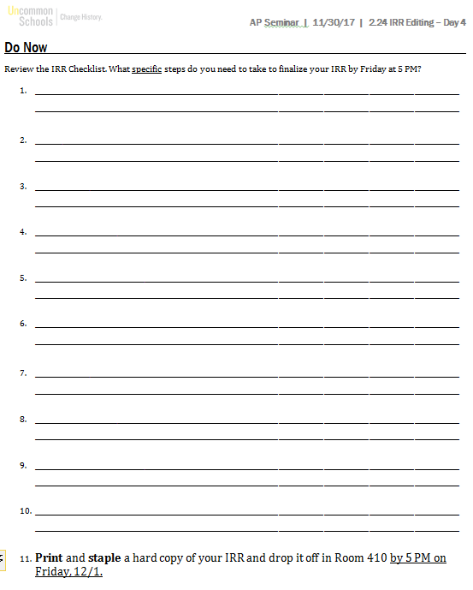
Exit Ticket
Check off the steps you’ve completed in class.
Add any steps you need to take tonight to finalize your IWA.

Slide 9
(Almost! At 5 PM [insert day]!)

Slide 10
Endnote
Author and Source Unknown. Uncommon Schools does not own the copyright for images used in this presentation and claims no copyright in this material. The material is being used exclusively for non-profit educational purposes under fair use principles in U.S. Copyright law. The user should make the judgment about whether this material may be used under fair use/fair dealing permissions in the user’s country.

