Slide 1
FIRST FIVE ARE SACRED.
Set your SMART goals for our IWA work time today.
Copyright: Uncommon Schools. Unless otherwise noted, all of the content in this resource is licensed under a Creative Commons Attribution International 4.0 (CC BY-NC-SA) license.

Slide 2
“We must run while others walk.”
OBJECTIVE
SWBAT draft 200 words of their Individual Written Argument (IWA).
AGENDA
IWA Work Time

Slide 3
Unit 3 Calendar

Slide 4
Agenda
IWA Work Time

Slide 5
PT2 Progress Check
On Track | Almost There | Off-Track

Slide 6
Progress Goal
IWA – 200 words
Resources to use:
IWA outline
Source Tracker
Annotated hard copies of sources
Annotated IWA exemplar
Conferences
Student Name
Student Name
Student Name
Student Name
Student Name

Slide 7
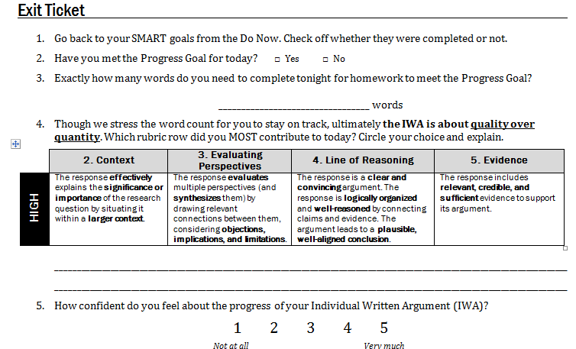
Exit Ticket

