Slide 1
FIRST FIVE ARE SACRED.
Set your SMART goals for our IRR work time today.
Copyright: Uncommon Schools. Unless otherwise noted, all of the content in this resource is licensed under a Creative Commons Attribution International 4.0 (CC BY-NC-SA) license.

Slide 2
“We must run while others walk.”
OBJECTIVE
SWBAT draft 1,000 words of their Individual Research Report (IRR).
AGENDA
IRR Workshop: Connecting Perspectives
IRR Work Time

Slide 3
Unit 2 Calendar

Slide 4
Agenda
IRR Workshop
IRR Work Time

Slide 5
Connecting Perspectives
Circle the exact words that differentiate a Low from a Medium from a High.

Slide 6
Evaluating Perspectives
At least 5 sentence stems you will use and highlight in your IRR today

Slide 7
Agenda
IRR Workshop
IRR Work Time

Slide 8
PT1 Progress Check
On Track | Almost There | Off-Track

Slide 9
Shout Outs!
Student 1
Student 2
Student 3

Slide 10
Progress Goal
IRR – 1,000 words
Resources to use:
IRR outline
Source Tracker
Annotated hard copies of sources
Annotated IRR exemplar
Conferences
Student Name
Student Name
Student Name
Student Name
Student Name

Slide 11
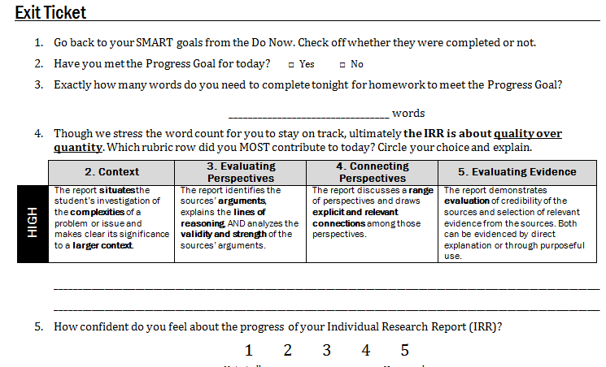
Exit Ticket

Slide 12
Endnotes
“They Say, I Say,” by Gerald Graff and Cathy Birkenstein, 2014. Uncommon Schools does not own the copyright in “They Say, I Say” and claims no copyright in this material. The material is being used exclusively for non-profit educational purposes under fair use principles in U.S. Copyright law. The user should make the judgment about whether this material may be used under fair use/fair dealing permissions in the user’s country.
Author and Source Unknown. Uncommon Schools does not own the copyright for images used in this presentation and claims no copyright in this material. The material is being used exclusively for non-profit educational purposes under fair use principles in U.S. Copyright law. The user should make the judgment about whether this material may be used under fair use/fair dealing permissions in the user’s country.

