Slide 1
FIRST FIVE ARE SACRED.
Review the IRR Outline for 3 minutes.
Copyright: Uncommon Schools. Unless otherwise noted, all of the content in this resource is licensed under a Creative Commons Attribution International 4.0 (CC BY-NC-SA) license.

Slide 2
“We must run while others walk.”
OBJECTIVE
SWBAT outline their Individual Research Report (IRR).
AGENDA
Outline Work Time

Slide 3
Unit 2 Calendar

Slide 4
Agenda
Research Work Time

Slide 5
PT1 Progress Check
On Track | Almost There | Off-Track

Slide 6
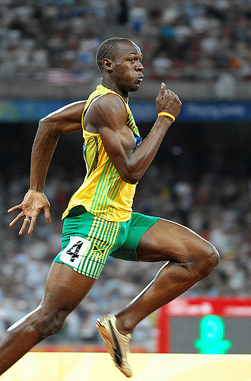
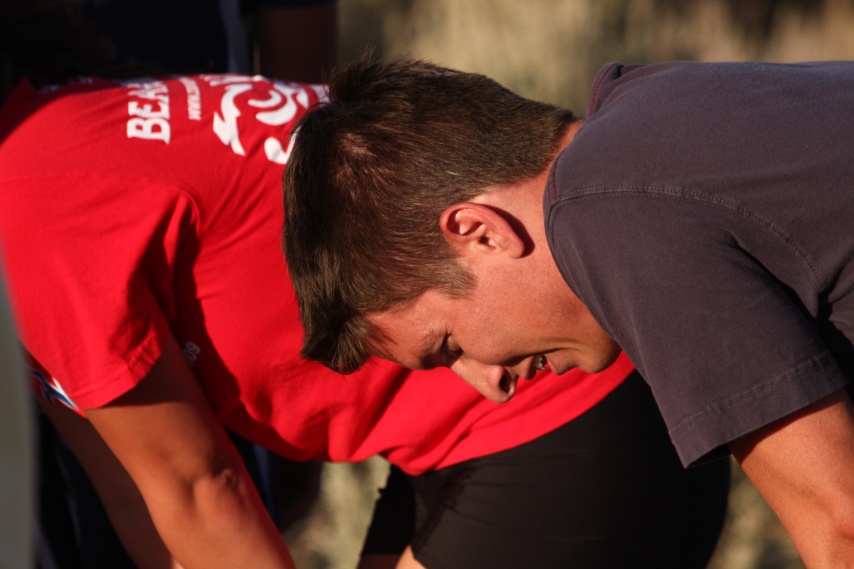
The IRR Outline
Didn’t finish the outline
Finished the outline

Slide 7
IRR Work Time
Use all sources from your Source Tracker. Find more if needed!
Report on the debate. What do different people believe about your topic and why?
Determine the central tension of your topic. Why is this a persistent challenge? What is the major obstacle?
Daily Progress Goal
IRR Outline

Slide 8
Endnote
Author and Source Unknown. Uncommon Schools does not own the copyright for images used in this presentation and claims no copyright in this material. The material is being used exclusively for non-profit educational purposes under fair use principles in U.S. Copyright law. The user should make the judgment about whether this material may be used under fair use/fair dealing permissions in the user’s country.

