Slide 1
FIRST FIVE ARE SACRED.
Review your team’s fact sheet, pledges, and opening statement.
Place all backpacks against the walls.
Copyright: Uncommon Schools. Unless otherwise noted, all of the content in this resource is licensed under a Creative Commons Attribution International 4.0 (CC BY-NC-SA) license.

Slide 2
“We must run while others walk.”
OBJECTIVE
SWBAT participate in a simulation of the 22nd Conference of Parties to the United Nations Framework Convention on Climate Change.
AGENDA
Introduction
The 22nd Conference of Parties to the United Nations Framework Convention on Climate Change
Closing

Slide 3
Agenda
Introduction
The 22nd Conference of Parties to the United Nations Framework Convention on Climate Change
Closing

Slide 4
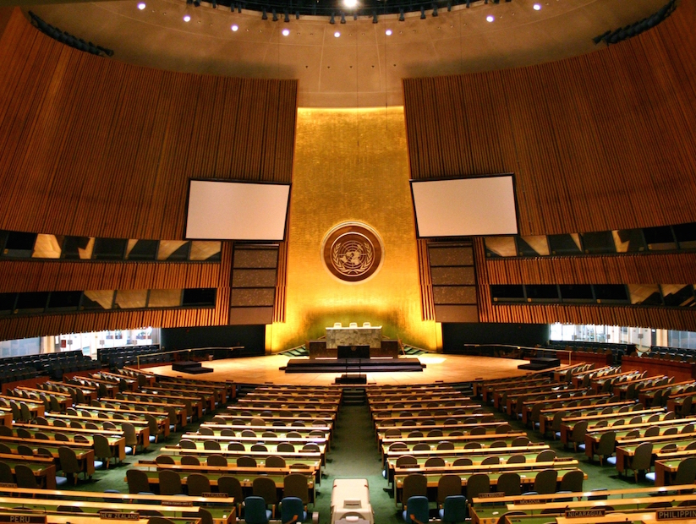
World Energy
WELCOME
The United Nations Framework Convention on Climate Change

Slide 5
Our Goals
Reduce greenhouse gas levels by 2100 at a level that keeps global warming below 2°C above preindustrial levels.
Agree on a deal to share costs of mitigation and adaptation fund to aid less developed nations.

Slide 6
Agenda
Introduction
The 22nd Conference of Parties to the United Nations Framework Convention on Climate Change
Closing

Slide 7
Round 1 Opening Statements

Slide 8
Opening Statement
United States of America

Slide 9
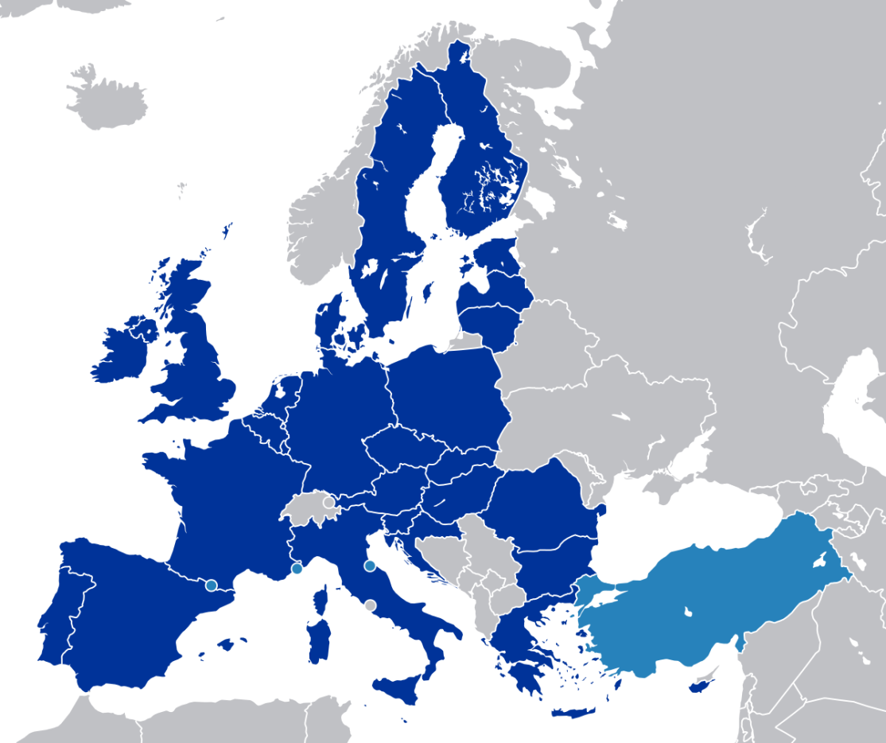
Opening Statement
European Union

Slide 10
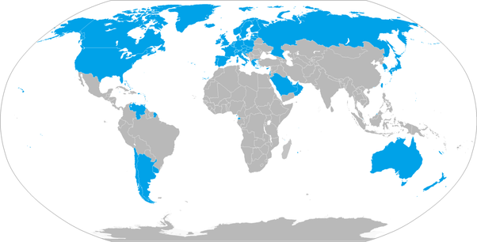
Opening Statement
Other Developed Countries

Slide 11
Opening Statement
China

Slide 12
Opening Statement
India

Slide 13
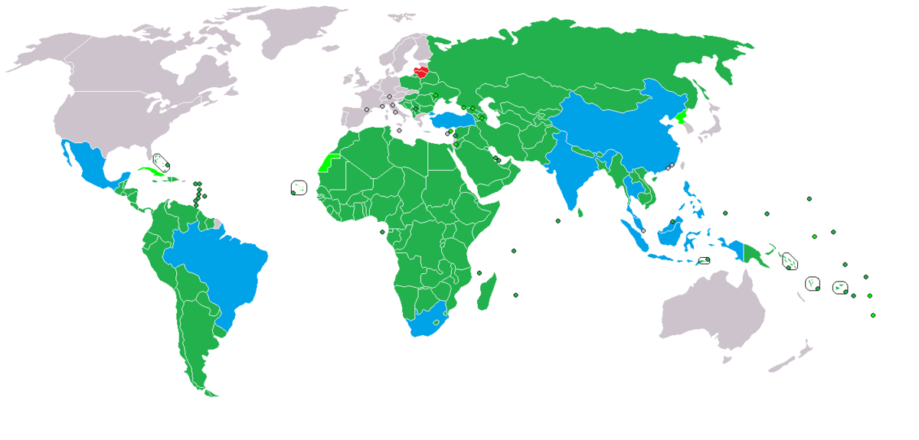
Opening Statement
Other Developing Countries

Slide 14
Round 1

Slide 15
Agenda
Introduction
The 22nd Conference of Parties to the United Nations Framework Convention on Climate Change
Day 1 Closing

Slide 16
Endnote
Author and Source Unknown. Uncommon Schools does not own the copyright for images used in this presentation and claims no copyright in this material. The material is being used exclusively for non-profit educational purposes under fair use principles in U.S. Copyright law. The user should make the judgment about whether this material may be used under fair use/fair dealing permissions in the user’s country.

