Slide 1
FIRST FIVE ARE SACRED.
Open up your Practice IRR Google Doc and share it with each of your teammates.
Read and annotate the PT1 directions for the Team Presentation.
Copyright: Uncommon Schools. Unless otherwise noted, all of the content in this resource is licensed under a Creative Commons Attribution International 4.0 (CC BY-NC-SA) license.

Slide 2
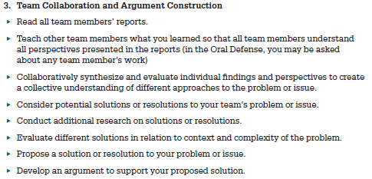
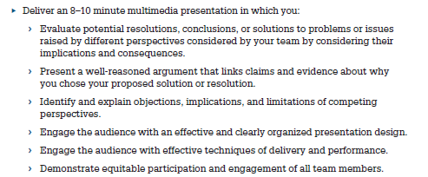
Team Presentation

Slide 3
“We must run while others walk.”
OBJECTIVE
SWBAT synthesize their teammates’ IRRs into 1 team/country position and complete an outline for their team presentation.
AGENDA
Reading Teammates’ IRRs
Team Presentation Outline Work Time

Slide 4
Agenda
Reading Teammates’ IRRs
Team Presentation Outline Work Time

Slide 5
Agenda
Reading Teammates’ IRRs
Team Presentation Outline Work Time

Slide 6
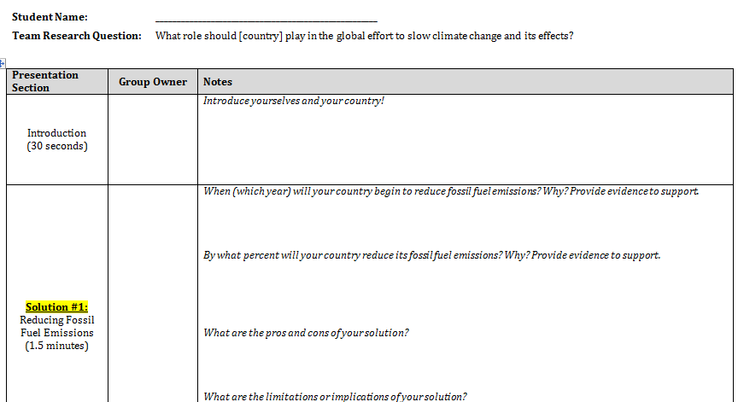
Team Presentation Outline

