Slide 1
FIRST FIVE ARE SACRED.
Complete your Do Now in 3.5 minutes.
Place your PW in the top right corner of your desk.

Slide 2
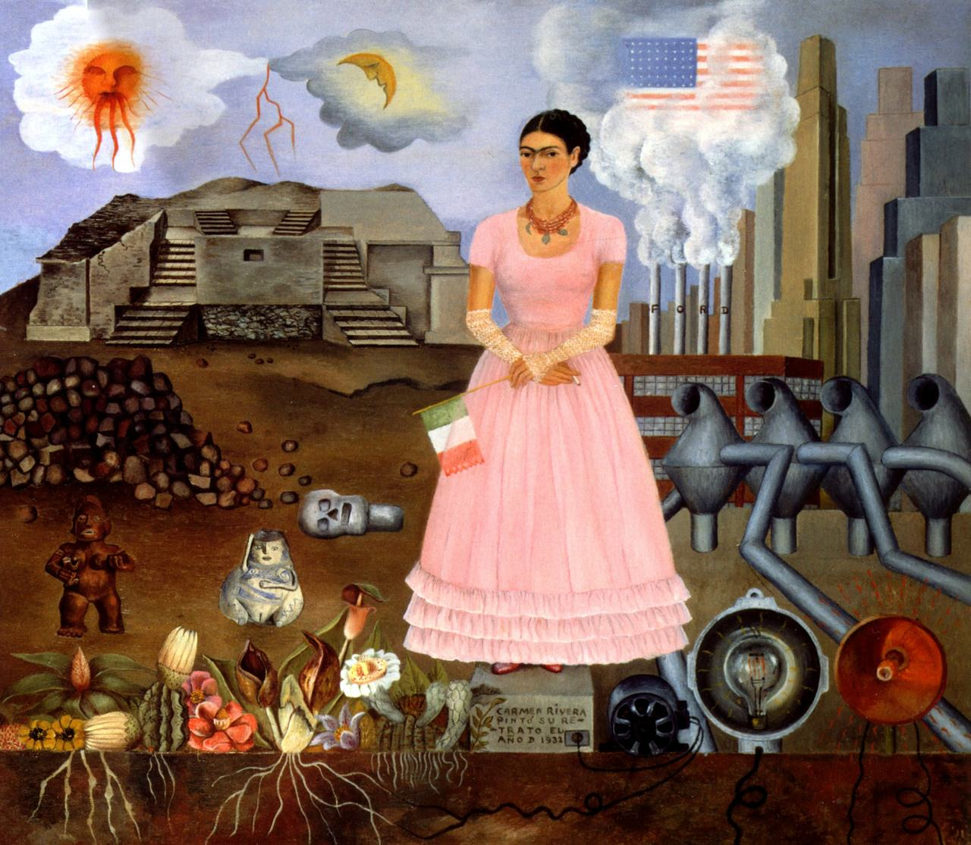
What can you infer about Frida’s identity? Who is she? What kind of person? How do you know?
Self Portrait Along the Border Line Between Mexico and the United States, 1932 by Frida Kahlo

Slide 3
“We must run while others walk.”
OBJECTIVE
SWBAT analyze Sandra Cisneros’ “My Name” to inspire a personal freewrite.
AGENDA
You & Your Name
Freewrite

Slide 4
Agenda
You & Your Name
Freewrite

Slide 5
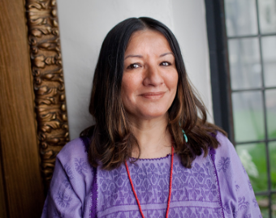
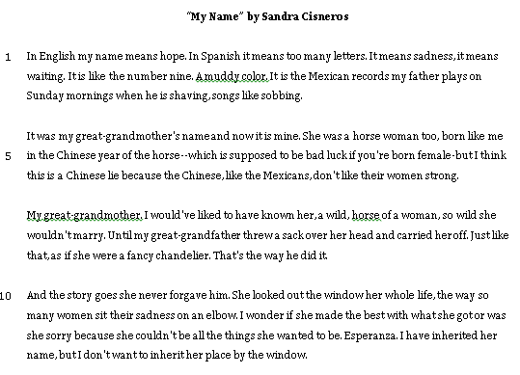
Sandra Cisneros

Slide 6
“My Name” Questions
Describe the speaker.
Write a 1-sentence summary of this piece.
What is the tone of this passage?
Are names important? Why or why not?

Slide 7
You & Your Name
What is the connection between your name and your sense of self/identity?
In what ways is your name meaningful (or not)?

Slide 8
You & Your Name
2 pages handwritten
Written format of your choice
Essay
Poem
Follow writing conventions
Descriptive, personal, original

Slide 9
Agenda
You & Your Name
Freewrite

Slide 10
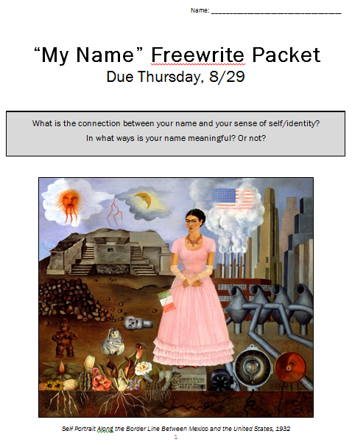

Slide 11
Endnotes
"Self Portrait Along the Border Line Between Mexico and the United States, 1932" by Frida Kahlo. Uncommon Schools does not own the copyright in “Self Portrait Along the Border Line Between Mexico and the United States, 1932” and claims no copyright on this material. The material is being used exclusively for non-profit educational purposes under fair use principles in U.S. Copyright law. The user should make the judgment about whether this material may be used under fair use/fair dealing permissions in the user’s country.
“My Name” by Sandra Cisneros. Uncommon Schools does not own the copyright in “My Name” and claims no copyright on this material. The material is being used exclusively for non-profit educational purposes under fair use principles in U.S. Copyright law. The user should make the judgment about whether this material may be used under fair use/fair dealing permissions in the user’s country.

