Slide 1
FIRST FIVE ARE SACRED.
Set your SMART goals for our research work time today.
Copyright: Uncommon Schools. Unless otherwise noted, all of the content in this resource is licensed under a Creative Commons Attribution International 4.0 (CC BY-NC-SA) license.

Slide 2
“We must run while others walk.”
OBJECTIVE
SWBAT draft 100 words of their Practice Individual Research Report (IRR).
AGENDA
Practice IRR Google Doc Set Up
Writing Work Time

Slide 3
Agenda
Practice IRR Google Doc Set Up
Writing Work Time

Slide 4
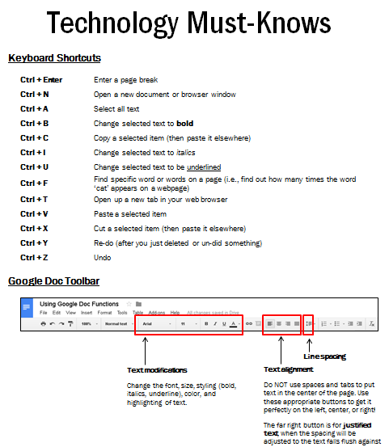
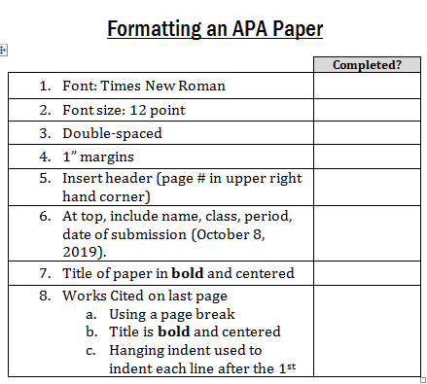
APA Paper Format

Slide 5
Agenda
Practice IRR Google Doc Set Up
Writing Work Time

Slide 6
Progress Goal
IRR – 100 words
Use your IRR outline!
Use your Source Tracker!
Use your hard copy sources with annotations!

