Slide 1
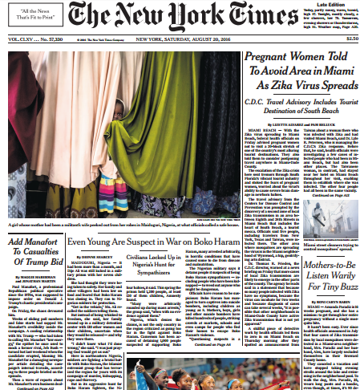
FIRST FIVE ARE SACRED.
Weekly News Quiz!
Copyright: Uncommon Schools. Unless otherwise noted, all of the content in this resource is licensed under a Creative Commons Attribution International 4.0 (CC BY-NC-SA) license.

Slide 2
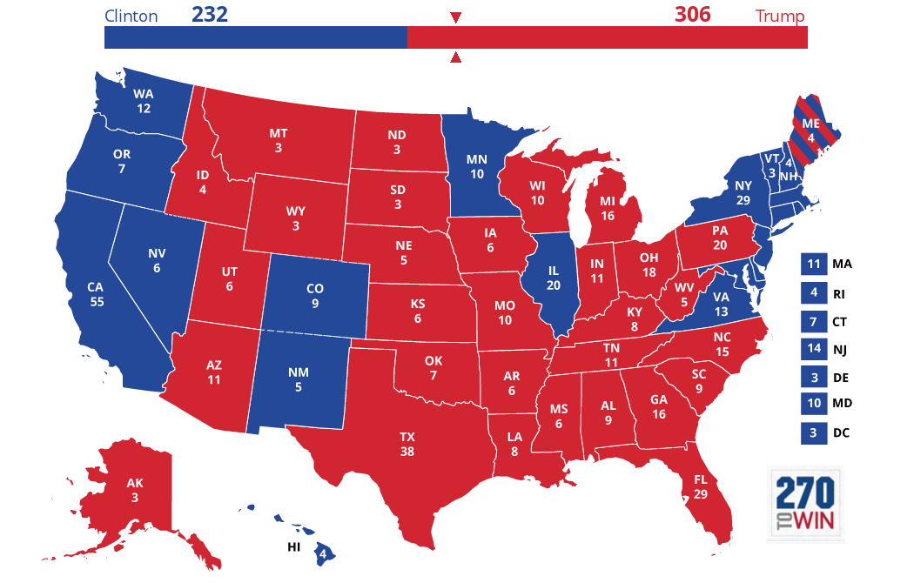
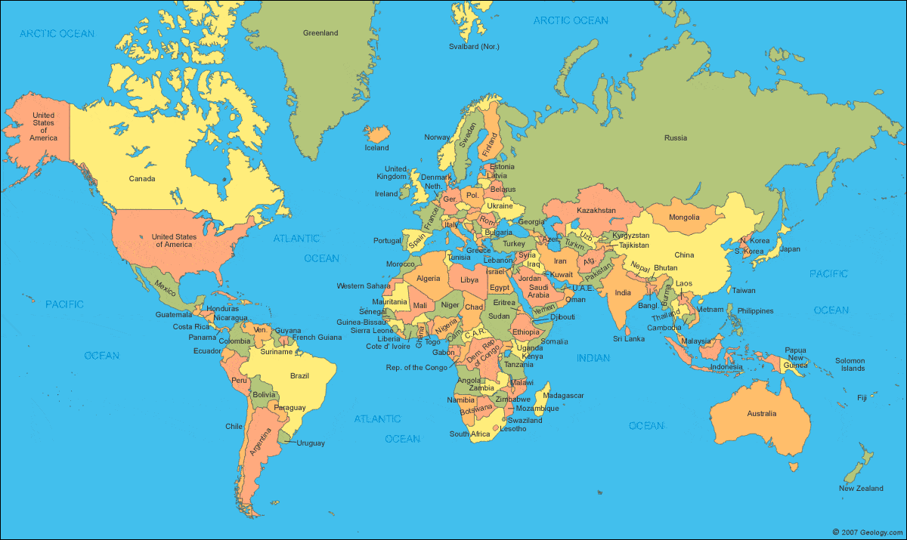
News Discussion

Slide 3
“We must run while others walk.”
OBJECTIVE
SWBAT analyze an Individual Research Report to identify key elements that fulfill the AP rubric criteria.
AGENDA
Performance Task 1: Team Project & Presentation
IRR Analysis
Team Exit Ticket

Slide 4
Agenda
Performance Task 1: Team Project & Presentation
IRR Analysis
Team Exit Ticket

Slide 5
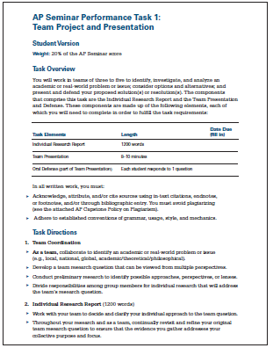
PT1: Team Project & Presentation

Slide 6
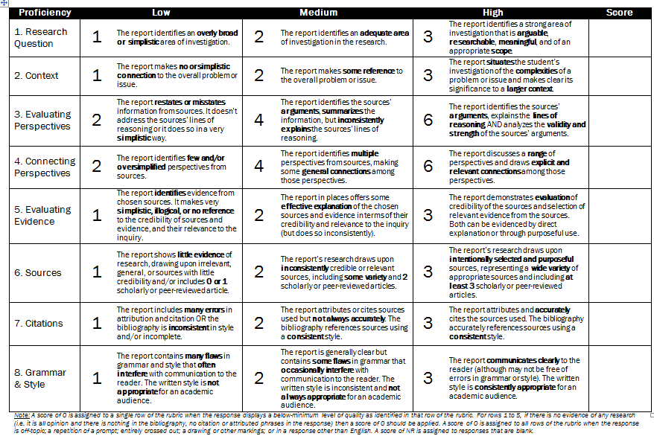
Individual Research Report Rubric

Slide 7
Agenda
Performance Task 1: Team Project & Presentation
IRR Analysis
Team Exit Ticket

Slide 8
Agenda
Performance Task 1: Team Project & Presentation
IRR Analysis
Team Exit Ticket

Slide 9
Team Exit Ticket
Within each country delegation, decide who will write an IRR on which lens:
Political
Economic
Social & Cultural
Environmental

Slide 10
Exit Ticket
E.U. (France)
United States
China
India
Brazil
Australia

Slide 11
Endnote
Author and Source Unknown. Uncommon Schools does not own the copyright for images used in this presentation and claims no copyright in this material. The material is being used exclusively for non-profit educational purposes under fair use principles in U.S. Copyright law. The user should make the judgment about whether this material may be used under fair use/fair dealing permissions in the user’s country.

