Slide 1
Tiers of Source Credibility

Slide 2
Tier 1
Peer-reviewed academic journals, books
MOST CREDIBLE
LEAST CREDIBLE

Slide 3
Tier 2
Specialized publications, government sources
Tier 3
Newspapers, reputable organizations

Slide 4
Tier 4
Popular magazines, popular media
Tier 5
Wikipedia, social media, blogs, general sites

Slide 5
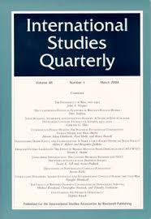
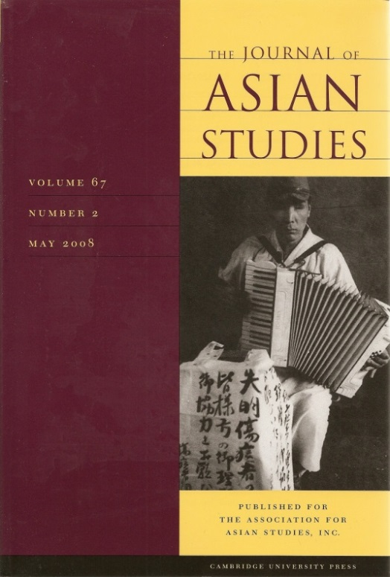
TIER 1

Slide 9
TIER 5

Slide 10
Research Databases

Slide 13
Endnote
Author and Source Unknown. Uncommon Schools does not own the copyright for images used in this presentation and claims no copyright in this material. The material is being used exclusively for non-profit educational purposes under fair use principles in U.S. Copyright law. The user should make the judgment about whether this material may be used under fair use/fair dealing permissions in the user’s country.

