Slide 1
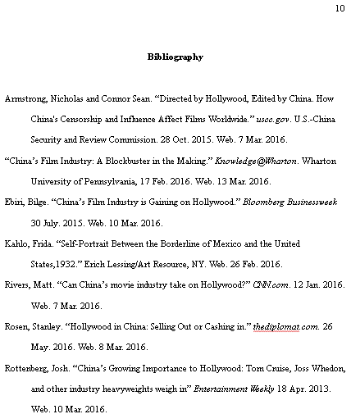
Collegiate Research Papers
Heading name, class, period, and date
Title bolded and centered
Header page #
Works Cited final page includes all cited sources
In-text citations
Font
Times New Roman, size 12
Text double-spaced
1-inch margins

