Slide 1
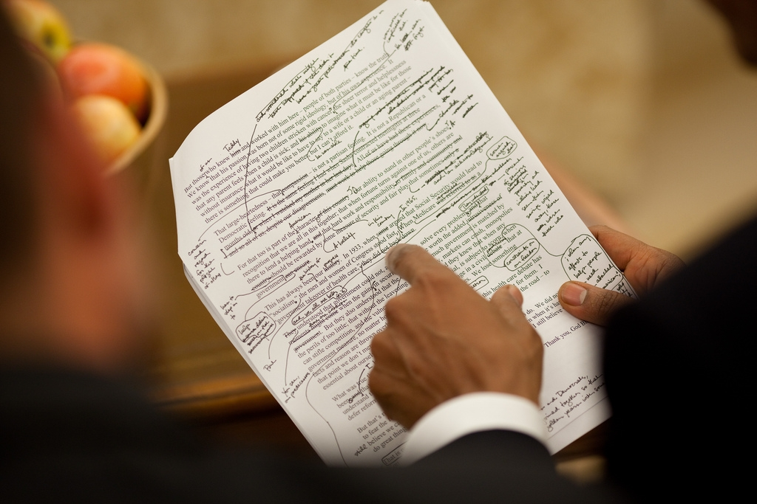
Your first draft is never your best draft.
Notes:
Timer: 40 minutes

Slide 2
Endnote
Author and Source Unknown. Uncommon Schools does not own the copyright for images used in this presentation and claims no copyright in this material. The material is being used exclusively for non-profit educational purposes under fair use principles in U.S. Copyright law. The user should make the judgment about whether this material may be used under fair use/fair dealing permissions in the user’s country.

