Slide 1
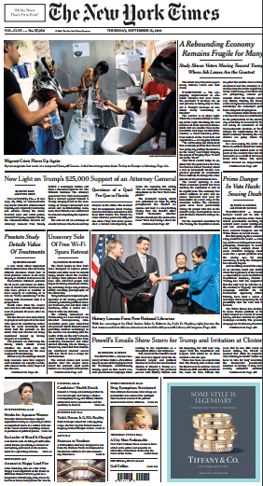
Understanding the World We Live In
In AP Seminar, we read the front page of The New York Times every day to gain a broader perspective of the world and to discover our unique academic interests.
Take a card and post it!
What was your reaction to a particular story?
What questions do you have about a topic?
What does this make you think of?
What do you wish you knew more about?
What connections did you make between stories?

Slide 2
Endnote
New York Times. Uncommon Schools does not own the copyright for the New York Times image used in this presentation and claims no copyright in this material. The material is being used exclusively for non-profit educational purposes under fair use principles in U.S. Copyright law. The user should make the judgment about whether this material may be used under fair use/fair dealing permissions in the user’s country.

