Slide 1
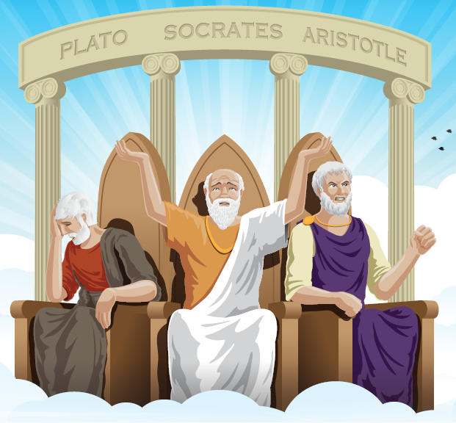
Logical Fallacies
Beware of flaws in reasoning!

Slide 2
Fallacies of Relevance
Does the claim address the question?
Fallacies of Presumption
What assumptions exist in the claim?
Fallacies of reasoning
Do the claims connect and build logically?

Slide 3
Straw man
Misrepresenting another’s argument to make it easier to strike down
After Will said that we should put more money into health and education, Warren responded by saying that he was surprised that Will hates our country so much that he wants to leave it defenseless by cutting military spending.
Notes:
Presumption

Slide 4
False Dilemma
Presenting only 2 choices when many more exist
Noise from restaurants and bars in New York City should not be regulated at all because the silence would change the city’s culture and nightlife.
Notes:
Presumption

Slide 5
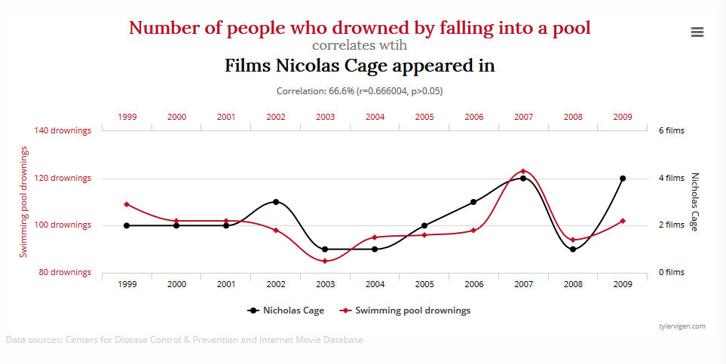
Post hoc ergo propter hoc
X happened before Y. Therefore, X caused Y.
Assuming correlation equals causation.
The rooster crows before sunrise, therefore the crowing rooster causes the sun to rise.
Notes:
Presumption

Slide 6
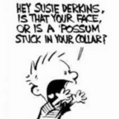
Ad hominem
Latin: “to the person”
Attacking a person’s character rather than addressing the issue
His attacks on religion obviously stem from the fact that he's a narrow-minded bigot who never had the inclination to pray for the benefit of anyone else.
Notes:
Relevance

Slide 7
Appeal to emotion
Using emotion instead of evidence to justify the conclusion
Luke didn't want to eat his brussels sprouts, but his father told him to think about the poor, starving children in a country who weren't fortunate enough to have any food at all.
Notes:
Relevance

Slide 8
Red herring
An irrelevant claim that misleads or distracts from the issue
I would love to answer your question on the health care budget. But let me begin by talking about the value of stem cell research.
Notes:
Relevance

Slide 9
Circular reasoning
A circular argument that begins by assuming what is meant to be proven
The reason there is such a big demand for club membership is because everyone wants to get into them.
Notes:
Reasoning

Slide 10
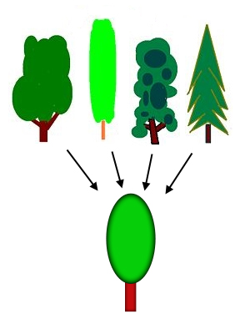
Hasty generalization
Making a claim from insufficient evidence
An environmental group in Oregon illegally blocked loggers and workers at a nuclear plant. Therefore, environmentalists are radicals who take the law into their own hands.
Notes:
Reasoning

Slide 11
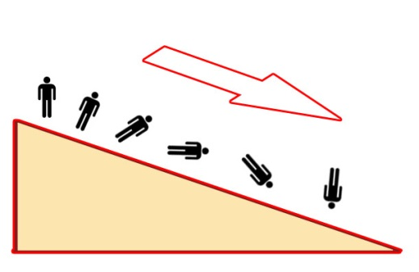
Slippery slope
Claiming without evidence that an action will inevitably lead to an effect
You should never gamble. Once one starts to gamble, they lose all their money and eventually turn to crime to support more gambling.
Notes:
Reasoning

Slide 12
Endnote
Author and Source Unknown. Uncommon Schools does not own the copyright for images used in this presentation and claims no copyright in this material. The material is being used exclusively for non-profit educational purposes under fair use principles in U.S. Copyright law. The user should make the judgment about whether this material may be used under fair use/fair dealing permissions in the user’s country.

