Slide 1
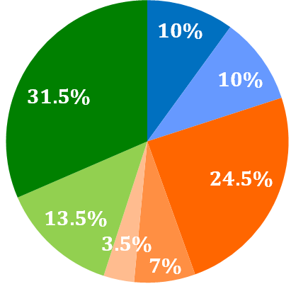
AP Seminar Assessment Tasks
Task #1: Team Nov – Jan
Task #2: Individual Feb - Apr
Task #3: Exam May 8, 2018

Slide 2
#1 | Team Project & Presentation | 20% of AP score
Individual Research Report (IRR)
Investigate a specific perspective or lens of the team’s chosen topic and research question in a 1,200 word report.
Team Multimedia Presentation (TMP) & Oral Defense
Deliver a 8-10 minute team presentation and defend your team’s conclusions and solutions, with each team member responding to 1 Oral Defense question.
10% of AP score
10% of AP score

Slide 3
#2 | Individual Research-Based Essay & Presentation | 35% of AP score
Individual Written Argument (IWA)
Develop a well-researched, coherent, and convincing argument of 2,000 words on a topic inspired by the College Board’s stimulus materials.
Individual Multimedia Presentation (IMP)
Deliver a 6-8 minute presentation, presenting your argument and supporting evidence and situating them within a broader context.
Oral Defense
Defend your research process, use of evidence, and conclusion
through oral responses to 2 questions asked by the teacher
24.5% of AP score
7% of AP score
3.5% of AP score

Slide 4
#3 | End-of-Course Exam | 45% of AP score
Part A: Argument Analysis
Analyze an argument in 3 short answer questions:
Identify the main idea.
Explain the line of reasoning.
Analyze the effectiveness of evidence.
Part B: Synthesis Essay
Build your own well-reasoned argument that presents your own unique perspective on the theme presented in 4 sources.
13.5% of AP score
31.5% of AP score

